Slide 1
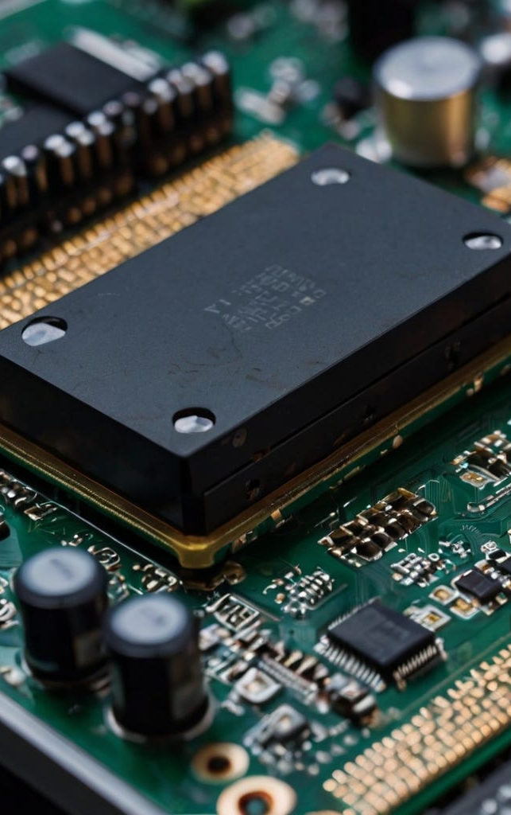
Unit 5013 - Embedded Systems
Smart Environmental Monitoring System
by Akbar Qamar

Slide 2


Slide 3
What will we Do?
We will design, simulate, implement, test and explain a small environmental monitoring alarm.
The final project is built one verified function at a time.
No prior programming knowledge is assumed at the start of this sequence.
Notes:
- Explain that the surviving student work shows the intended final system: LDR, curtain switch, LED, buzzer and LCD status.
- The first question in every lab is: what should the system sense, decide and do?

Slide 4
Today's Learning Objectives
Define an embedded system and identify input, processing and output blocks.
Explain the role of an Arduino-compatible microcontroller.
Create, run and alter a first Arduino sketch in Tinkercad Circuits.
Use setup(), loop(), pinMode() and digitalWrite().
Capture evidence of a working simulator lab.

Slide 5
What Is an Embedded System?
A small computer built into a product to perform a dedicated job.
It observes the world through inputs, processes information and controls outputs.
Examples: thermostat, washing machine, vehicle parking sensor, fire alarm and smart HVAC controller.

Slide 6
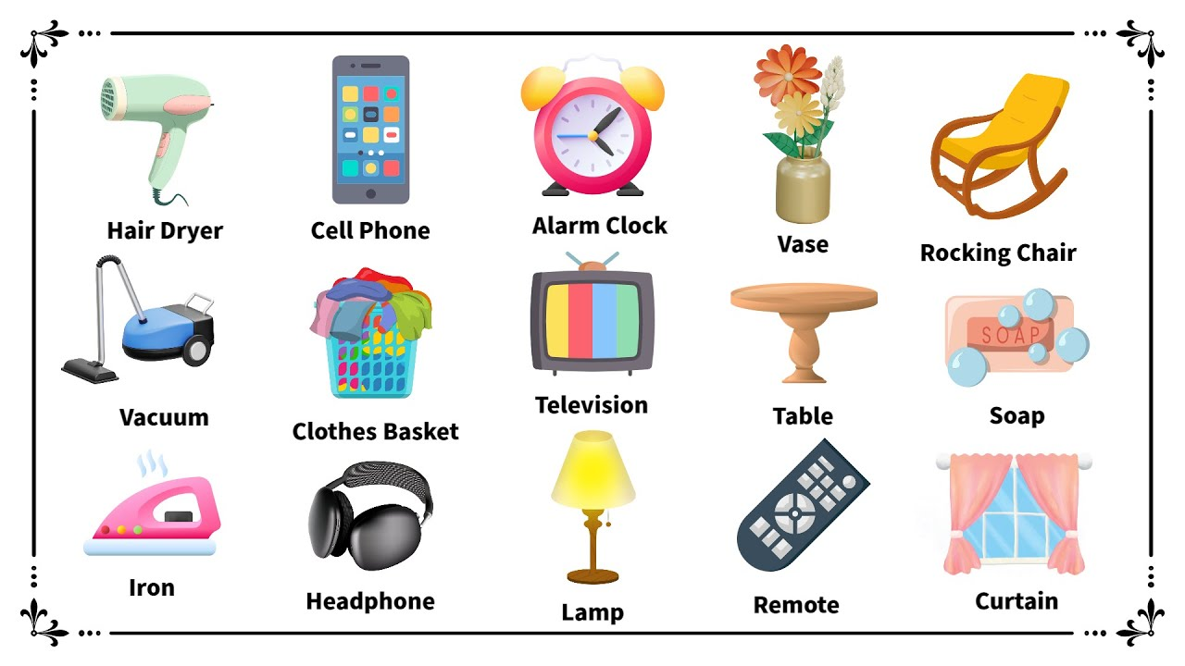
Notes:
Which one of these is an embedded system?

Slide 7

Our Project Context
EcoSmart needs an indoor comfort-monitoring prototype.
Input: light level from an LDR and a curtain switch.
Processing: compare reading with an agreed threshold.
Outputs: LED, buzzer and LCD status.
Evidence: code, block diagram, test plans/results, debugging record and individual LO3 video.

Slide 8
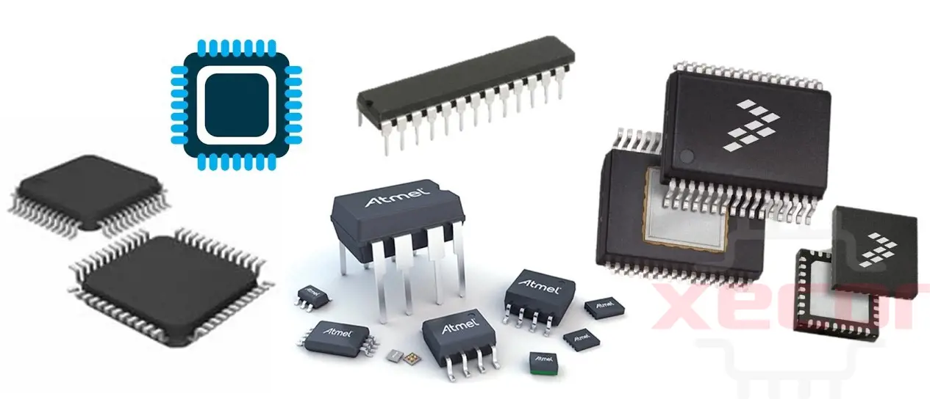

Slide 9
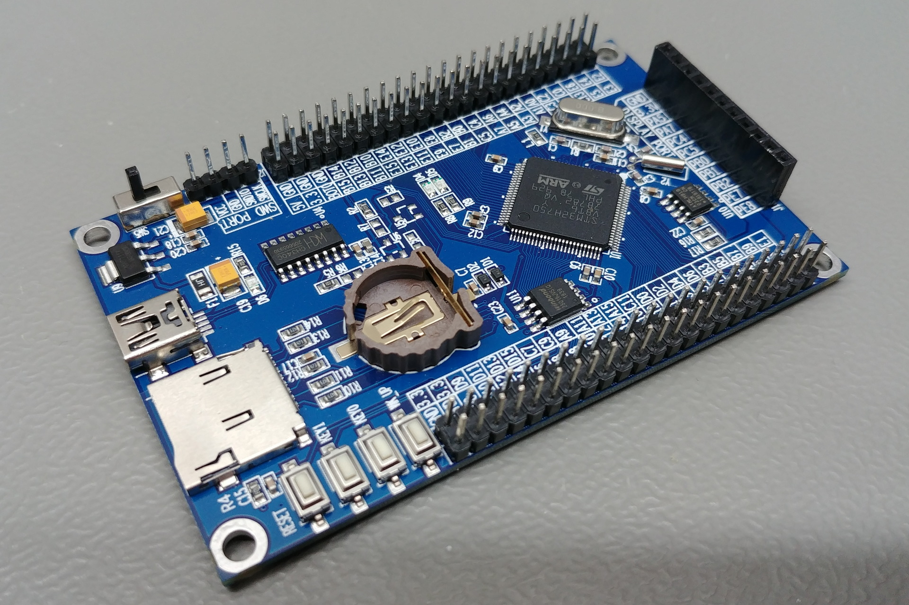

Slide 10
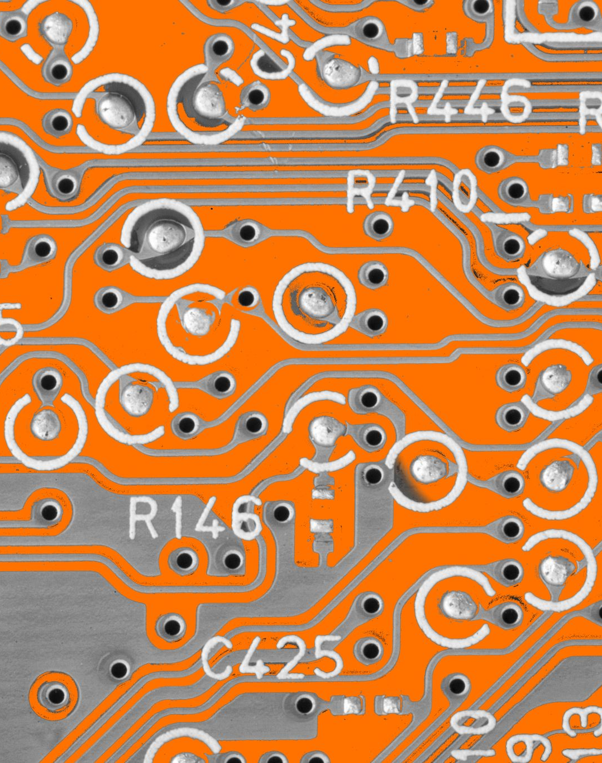
Arduino Uno as a Learning Platform
Microcontroller: ATmega328P.
Digital pins: read or write HIGH/LOW states.
Analogue pins: measure a varying voltage with analogRead().
USB connection: uploads the sketch and provides serial debugging.
It is simple enough for first programs and supports the project pattern directly.
Notes:
Make clear that students still compare Arduino-class boards, ESP32 and STM32 for LO1 selection. The Uno is the starting learning platform, not automatically the final recommendation.

Slide 11


Slide 12


Slide 13


Slide 14
Tinkercad and Wokwi
Tool | Use it for
Tinkercad Circuits | First circuits, Arduino Uno, LEDs, buttons, LDRs and beginner code
Wokwi | I2C LCD, ESP32 extensions, serial monitor and shareable advanced simulations
Begin every lab in the stated simulator.
Save a named copy and take one working screenshot.
Simulation proves logic and wiring ideas; it does not replace real-hardware testing.

Slide 15
How an Arduino Sketch Runs
void setup() {
// Runs once when power is applied or reset.
}
void loop() {
// Runs repeatedly forever.
}
setup() configures hardware.
loop() repeatedly reads inputs, decides, then updates outputs.

Slide 16
Digital Output and Logic States
HIGH supplies a logic-on output state.
LOW supplies a logic-off output state.
pinMode(pin, OUTPUT) configures an output pin.
digitalWrite(pin, HIGH) commands the output on.
Safety note: use a resistor with an LED. Never use a microcontroller pin to power a motor, relay or high-current load directly.

Slide 17
First Program - Blink
const int ledPin = 13;
void setup() {
pinMode(ledPin, OUTPUT);
}
void loop() {
digitalWrite(ledPin, HIGH);
delay(1000);
digitalWrite(ledPin, LOW);
delay(1000);
}
Notes:
Read the code in order, then predict what will happen before running it.
Ask students to alter one number and describe the visible change.

Slide 18
Lab L01 - Blink in Tinkercad
Build: Arduino Uno, LED and 220 ohm resistor.
Do:
Connect the LED safely to digital pin 13 and ground.
Enter the Blink sketch.
Run the simulation.
Change the on/off timing to 250 ms and 750 ms.
Save the project as L01_Blink_StudentName.
Submit: screenshot, code and one sentence explaining setup() versus loop().

Slide 19
Variables Make Code Easier to Change
A variable stores a value that may change while the program runs.
A named constant makes a fixed value readable and avoids unexplained numbers.
const int redPin = 13;
const int delayMs = 500;
Use meaningful names: ledPin, lightValue, threshold.
Avoid unclear names such as x, a1 or thing.

Slide 20
Lab L02 - Timed Traffic Light
Build: three LEDs: red, amber and green, each with a resistor.
Requirements:
Green: 5 seconds.
Amber: 2 seconds.
Red: 5 seconds.
Use named pin constants and explain the sequence.
Extension: make amber flash three times before red.
Evidence: wiring screenshot, code and a flowchart with start, outputs and delays.

Slide 21
Lab Review - Debug in This Order
Is the circuit powered and grounded correctly?
Does the code use the pin actually wired?
Is the pin configured as OUTPUT?
Is the LED direction and resistor correct?
Can a simpler one-LED sketch work first?
Notes:
Demonstrate a deliberate wrong pin number and show how to identify it without guessing.

Slide 22
Link to the Assessment
L01/L02 build the implementation confidence needed for LO3.P4.
The platform comparison begins evidence for LO1.P1/P2/M1/D1.
Saved screenshots, code and reflections are evidence, not optional decoration.

Slide 23
Week 1 Exit Ticket
Explain one difference between an input and an output.
Identify which function runs once and which repeats.
Submit L01 and L02 evidence.
Begin a comparison table for Arduino Uno, ESP32 and STM32: processing, interfaces, communication, power, cost and tooling.

